Slide 1

Notes:
ESPC23 Branded Splash Screen
Slide #1 on all presentations.
The speaker should not edit, move or delete this slide.

Slide 2


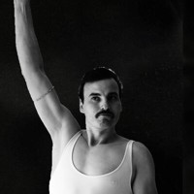
Let’s build the ultimate Power App: Reusable, Remarkable and Responsive
Luise Freese &
Independent Consultant, Germany
Robin Rosengrün
Enabler, EnBW AG, Germany
Notes:
Presentation Title Slide
Please input your presentation title, your name, title, company name and country.

Slide 3
Luise Freese
Independent M365 & Power Platform consultant
Dual Microsoft MVP in M365 Development & Business Applications
M365princess.com
Loves community, stickers, the number 42
“Fun fact”: I am a developer and I quit drinking coffee 😱

Slide 4
Luise Freese
Robin Rosengrün
Independent M365 & Power Platform consultant
Dual Microsoft MVP in M365 Development & Business Applications
M365princess.com
Loves community, stickers, the number 42
“Fun fact”: I am a developer and I quit drinking coffee 😱
Mechanical engineer turned Power Addict
Microsoft MVP in Business Applications
Speaks SVG fluently
Has a magic stick
“Fun fact”: Luise calls me a developer and I still drink coffee ☕

Slide 5
I am a developer AND passionate about good design…

Slide 6
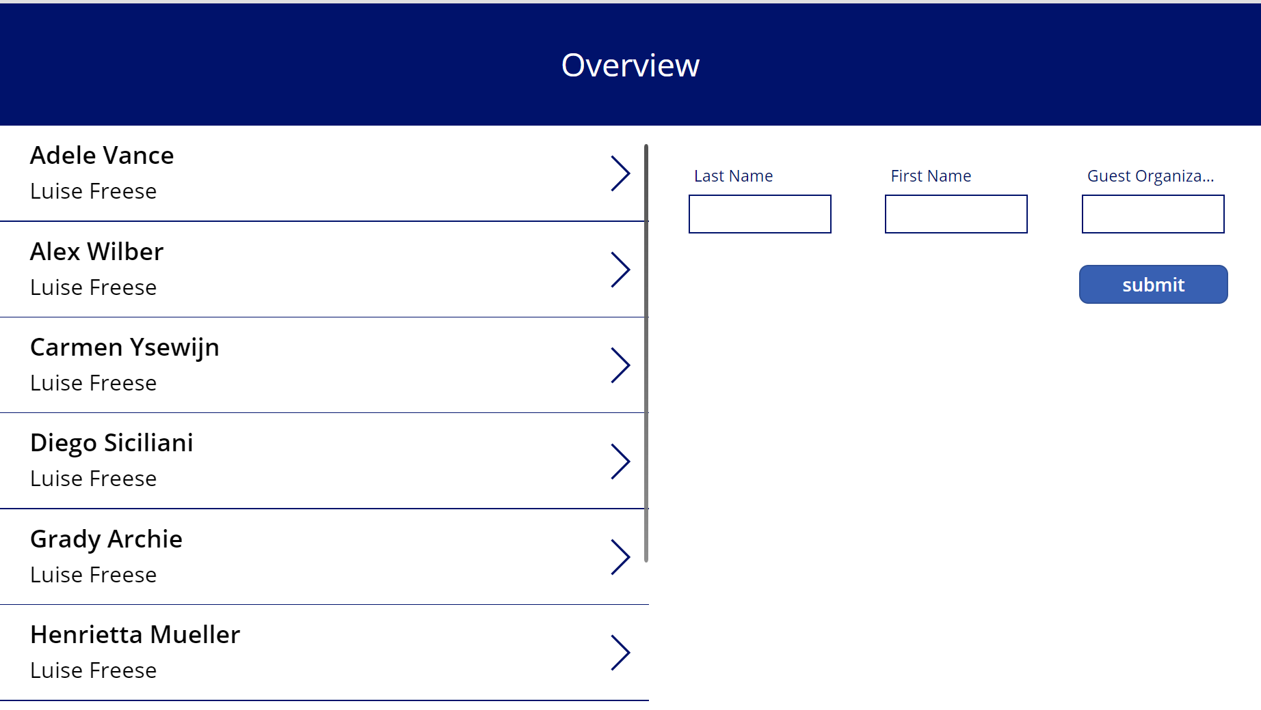
The ugly truth

Slide 7
Options for makers
The bad: Just live with the default style of controls and try to copy/paste more complex parts between apps
The ugly: Change Every.Single.Property.Of.Every.Single.Control and then create reference controls on a hidden screen and copy/paste the hell out of it 🙄

Slide 8
As a result
Outdated, inconsistent design
OOTB controls lack of useful functionality and pleasantful appearance
Makers need to reinvent the wheel over and over
Big differences across apps

Slide 9
Options for makers
The bad: Just live with the default style of controls and try to copy/paste more complex parts between apps
The ugly: Change Every.Single.Property.Of.Every.Single.Control and then create reference controls on a hidden screen and copy/paste the hell out of it 🙄
The good: Use a component library with a template app

Slide 10
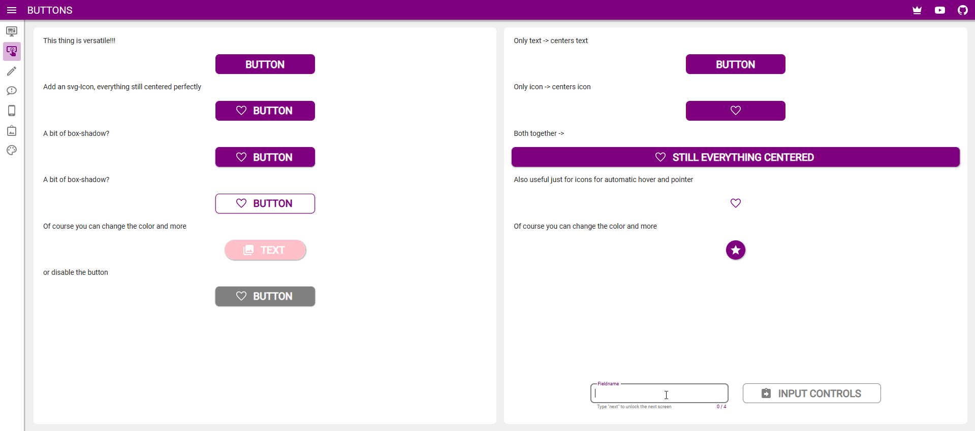
What if our apps looked like this?

Slide 11
Material Design
Design system built and supported by Google designers and developers
Widely adopted
Great documentation
Cares about accessibility first

Slide 12
We created a component library
16 components
Template App
Proper documentation
5000 SVGs
Setup time: < 5 min
Import component library
Start from template app
Change 1-10 default values to match your color scheme
🎉

Slide 13
Component libraries for Power Apps
What?!
Why?
Centralized repository in an environment for components
Apps maintain dependencies on the components they use
Makers are alerted when updates become available
Makers can easily discover new components
Single source of truth
Easy to maintain

Slide 14
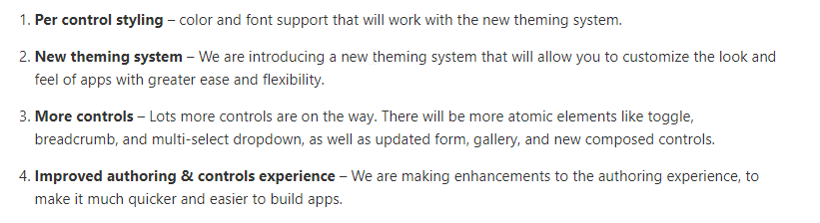
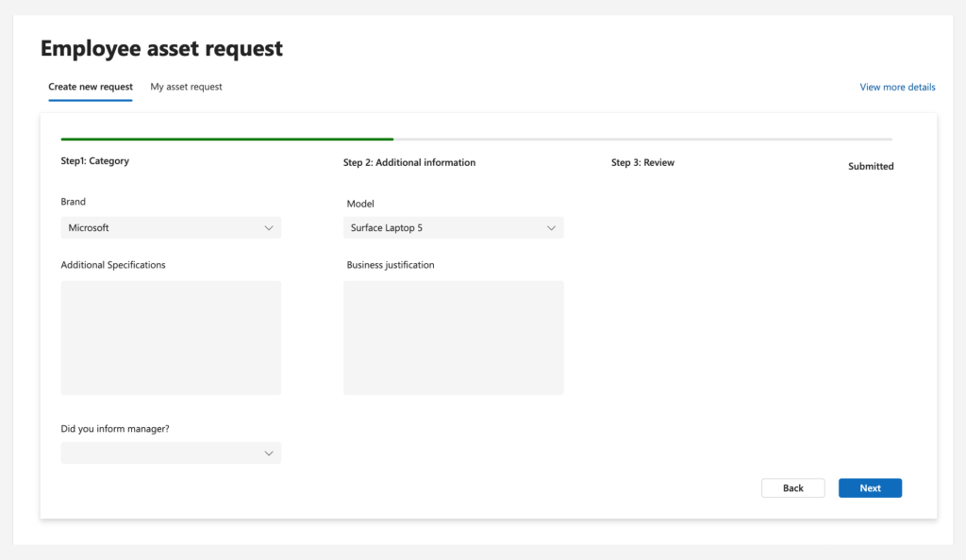
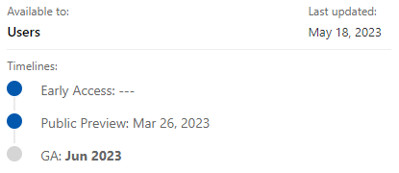
Modern controls

Slide 15
Info
https://m2.material.io/design
https://github.com/pnp/powerapps-designtoolkit
https://pnp.github.io/blog/post/material-design-component-library-for-power-apps/

Slide 16
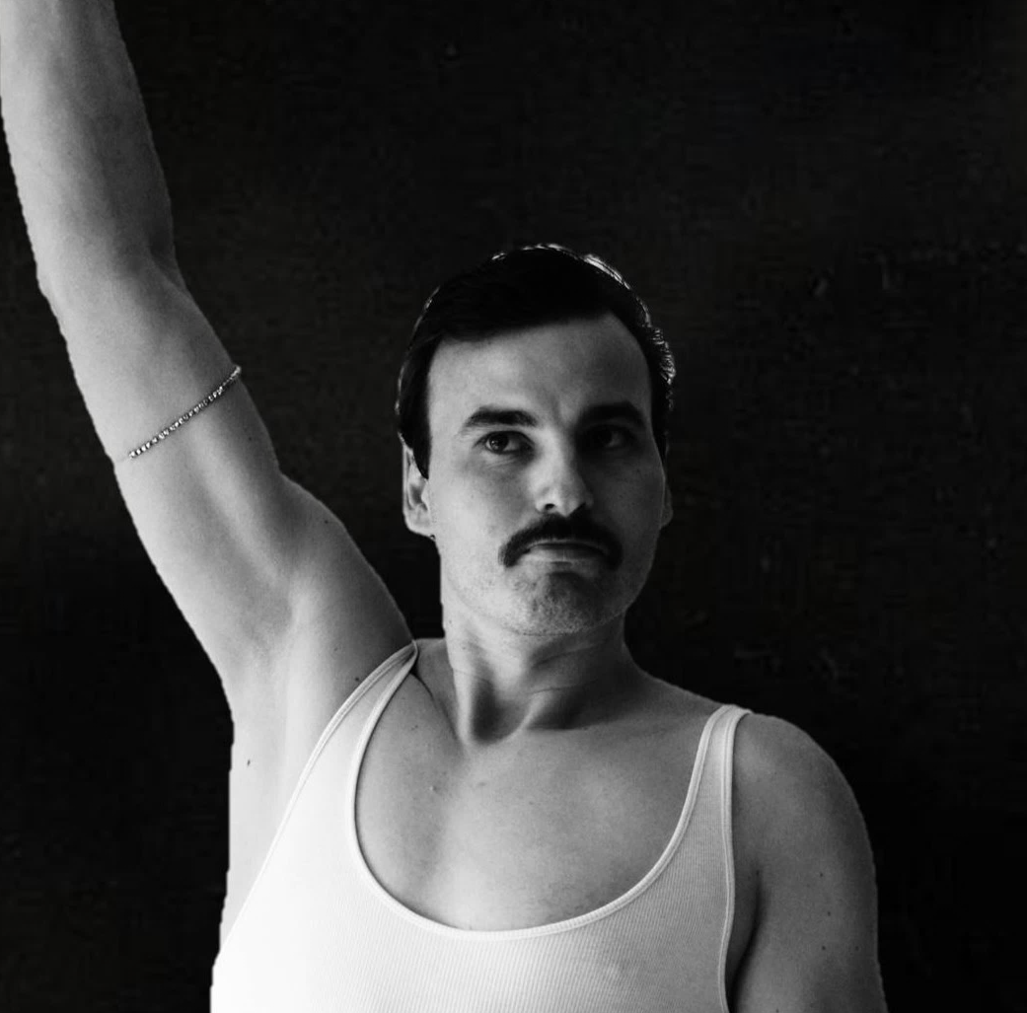
Luise Freese
Robin Rosengrün
Independent M365 & Power Platform consultant
Dual MVP in M365 Development & Business Applications
M365princess.com
Loves community, stickers, the number 42
Low Code 🥑 @EnBW
MVP in Business Applications
youtube.com/@r2power
speaks german, english & svg
Notes:
Main Content Slide – Dark Background : Title + Dual Copy Text
Use this slide for inserting two columns of text-only information into the Main Content of the presentation.
The text is preformatted with font and colour styles.
Font-size can be altered to allow the content to fit the slide correctly.
The Title Text Box can be deleted if not required.

Slide 17
Agenda
Intro & logistics
Icebreaker
Performance – how to speed up your app
COFFEEBREAK ~ 10:30 – 11:00
Components
LUNCHBREAK ~ 12:45 – 14:00
Accessibility
COFFEEBREAK ~ 15:15 – 15:45
Responsive Apps
END OF TUTORIAL ~ 17:00

Slide 18
Power Apps Design, Performance, and Accessibility Masterclass
https://github.com/LuiseFreese/PowerApps-ESPC23
WIFI: ESPC23 Password: espc23rai
Notes:
This is to always show when in break or when attendees do an exercise

Slide 19
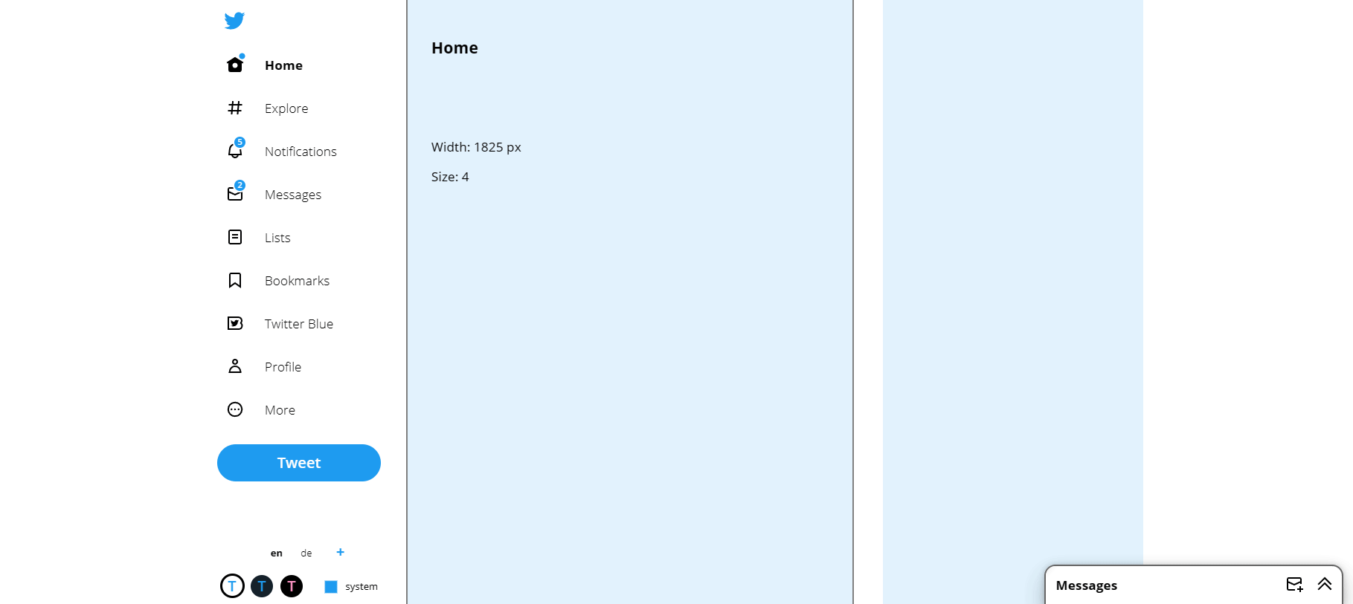
Todays exercises: build twitter

Slide 20

What is performance?

Slide 21
Performance is not something that we can magically apply after we build an app.

Slide 22

Performance is a result of valuable architecture decisions and good coding practices

Slide 23

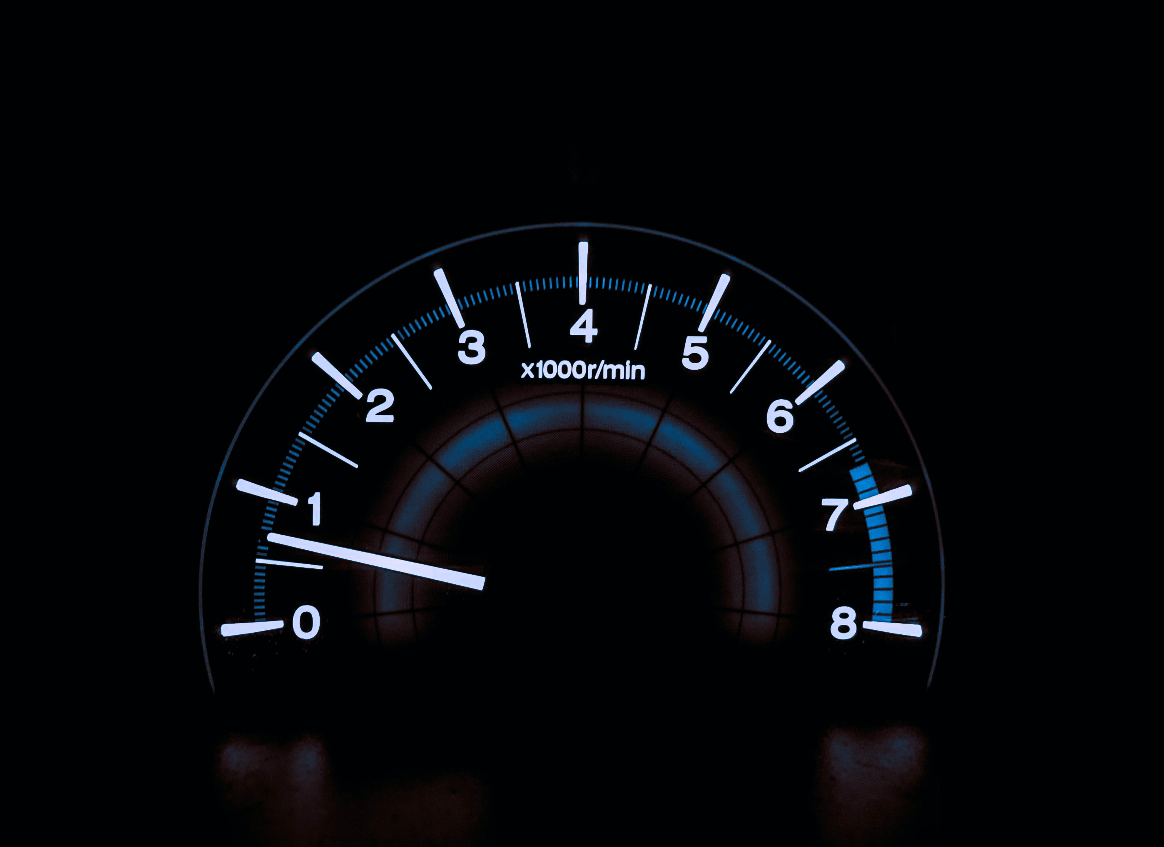
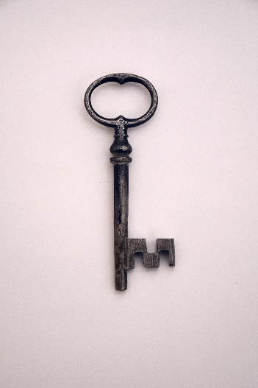
Why would we care?
They are spoiled from their experiences with fast websites
Users expect fast apps
Performance and acceptance go hand in hand
Notes:
The average time a person will wait for a web page to load before leaving is 3 seconds – same applies to apps
Lack of performance is usually a result from bad coding practices and poor design choices
Performance is a result

Slide 24
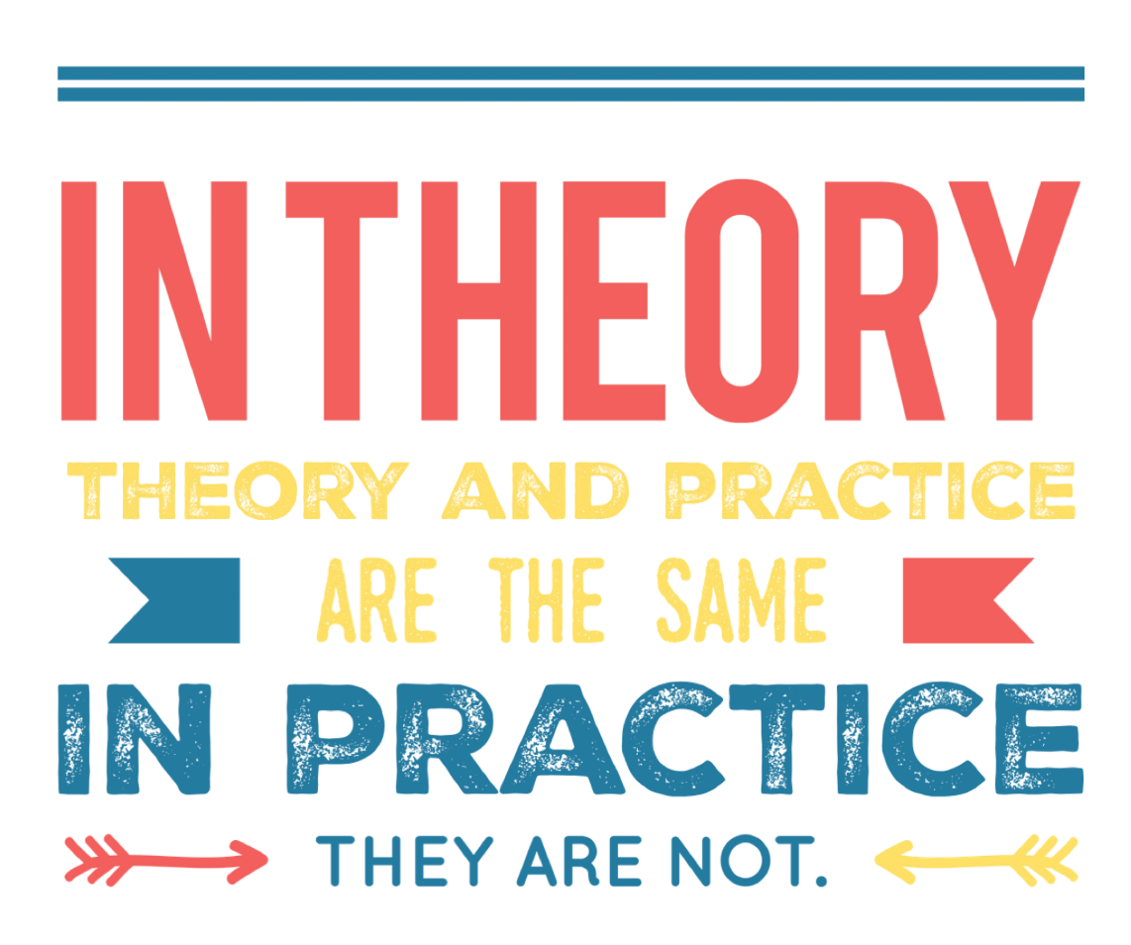
Databases
Technically, you can connect your Canvas app to almost every data
Practically, you shouldn’t.

Slide 25
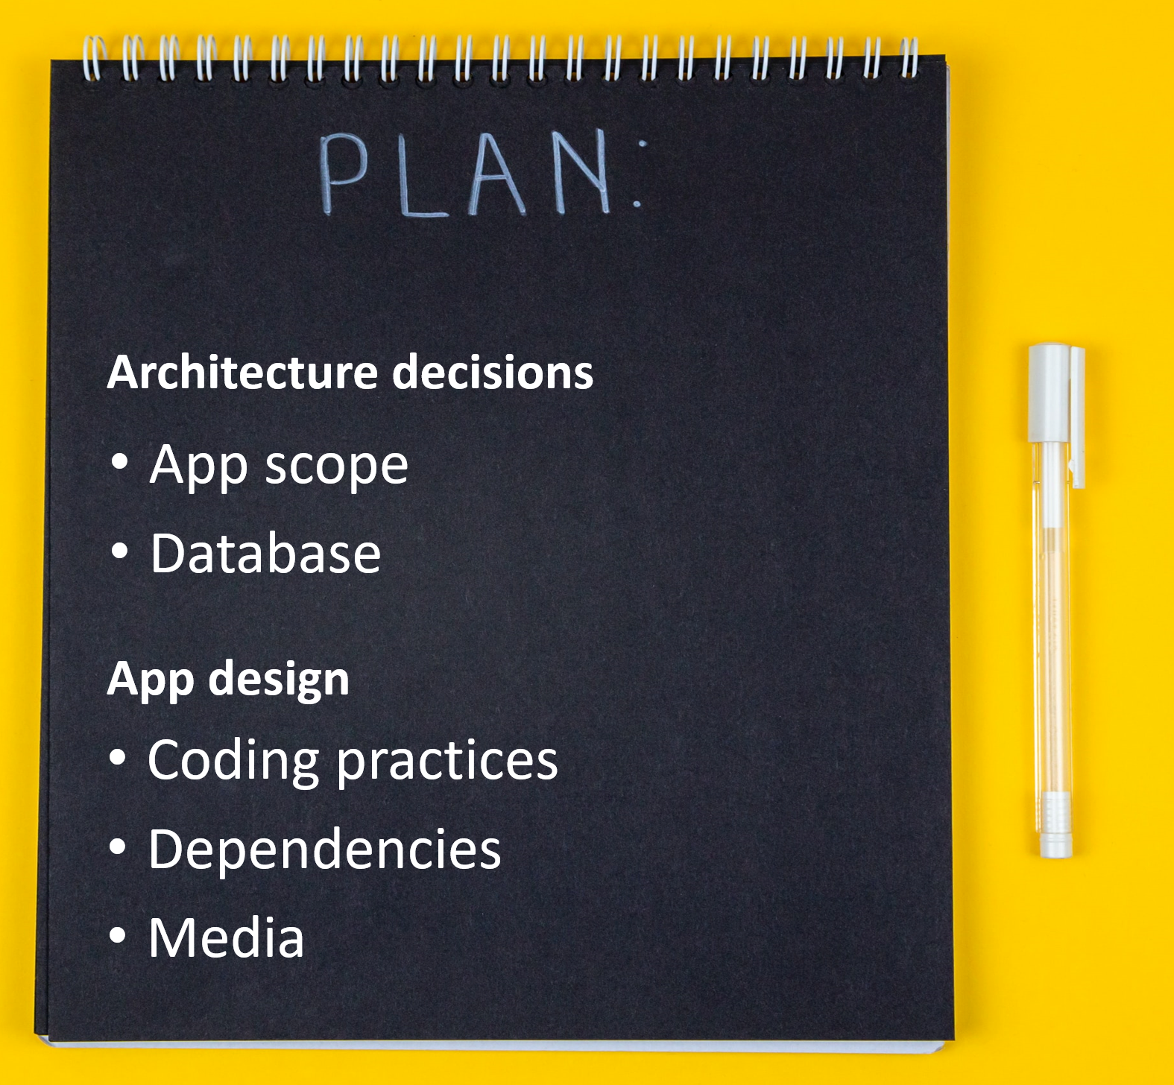
Plan!
Hours of thinking can spare weeks of (low)- coding

Slide 26
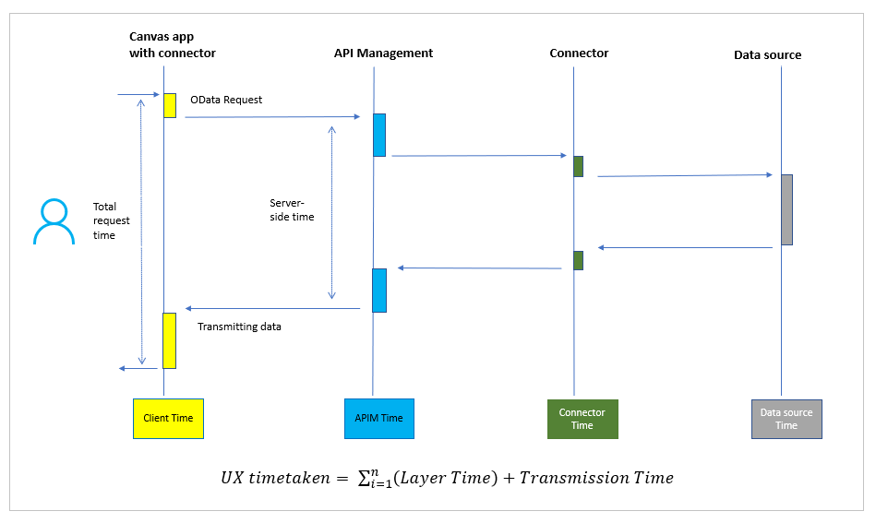
Typical data call flow
Data request travels several server-side layers until it reaches the target data source
Then it returns data to the client, passing again these layers

Slide 27
Typical data call flow
Data request travels several server-side layers until it reaches the target data source
Then it returns data to the client, passing again these layers

Slide 28
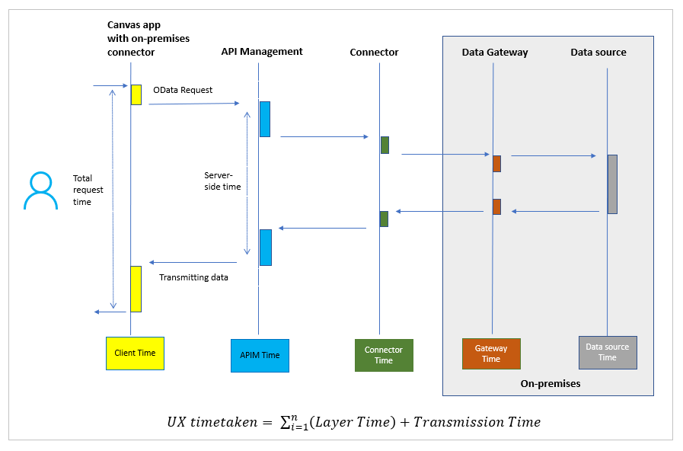
On prem data call flow
Slowest option
Data needs to travel through
APIM
the connector,
the data gateway
to the data source - and then back
Tipp: Consider to move on-prem data to cloud

Slide 29
Typical data call flow
Slowest option
Data needs to travel through
APIM
the connector,
the data gateway
to the data source - and then back
Tipp: Consider to move on-prem data to cloud

Slide 30
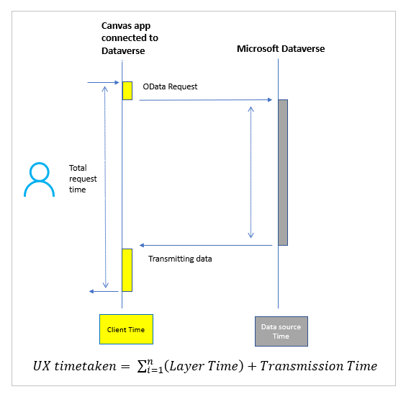
Data call flow with Microsoft Dataverse
Connect directly without passing through Azure API Management
no connector, no gateway
Fastest option

Slide 32

Excel
Just don’t.
Your datasource shouldn’t be a spreadsheet
Issues:
File needs to be in your OneDrive
Table can’t have any formulas
App can’t be used if the file is opened (it’s locked)
No delegation – which means heavy data processing is done in the app – which makes it slow

Slide 33

SharePoint
Issues with
complex column types
attached files
large lists (items)
many columns

Slide 34
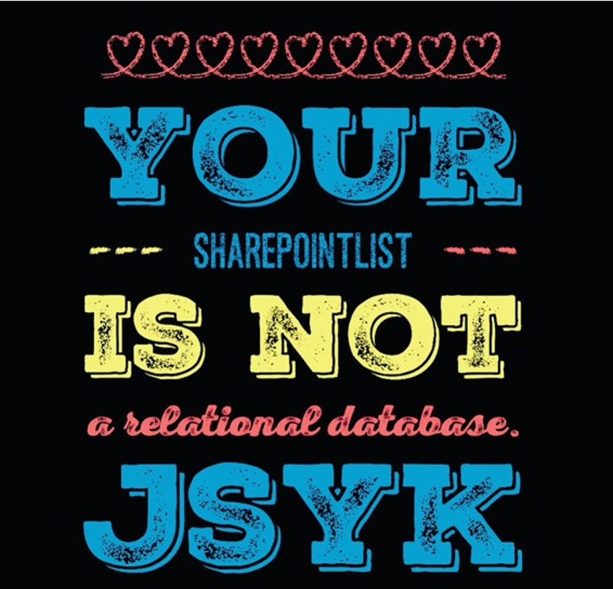
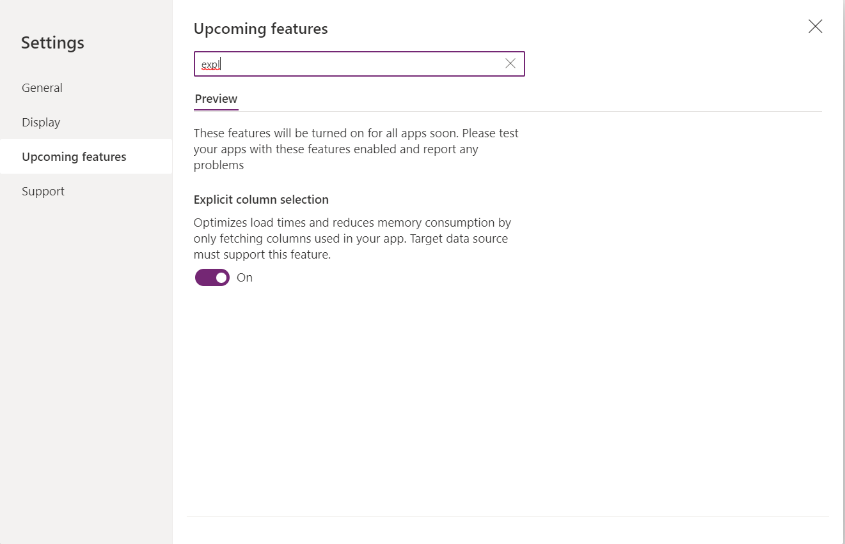
Tipp: Turn on explicit column selection

Slide 35

SQL
Choose right service tier to avoid throttling issues
Excessive geographical distance affects
Latency
reduced throughput
lower bandwidth
packet loss
Use views instead of tables to limit the amount of data that needs to be processed

Slide 36

Dataverse
By far! The most performant and secure database
Use views instead of entire tables

Slide 37
Discussion: SharePoint vs Dataverse

Slide 38





Discussion: When to use what
users
complexity

Slide 39
App Design – Do’s
Use OnStart property wisely
🙄 While OnStart code is running, users will continue to see the app splash screen and a “Getting your data” message
💡 Only to initialize the app
😇 Resist temptation to put data initialization calls there
Reuse everything
Components > controls (DRY)
Galleries for everything that needs to be repeated
Store error messages in variables
Handle user interaction smart
🚀Work locally with your data → ClearCollect()
🤝Execute more than one request simultaneously → Concurrent()
⚡ Make searching faster → Set Delay output: true

Slide 40
App Design - Don’ts
Avoid non delegable functions
First(Filter(‘MyData’, Startswith(Customer, “L”)) → LookUp(colmydata, StartsWith(Customer, “L”).Customer
Don’t make expensive calls while user is staring at the screen
Unpopular opinion: Don’t use a loading message box or spinner
Don’t inherit values of properties from controls that are located on other screens

Slide 41
Limit package size
Break up too complex apps
Delete media that is not needed
SVG > PNG
Delete unused screens

Slide 42
Some ideas for galleries
Navigation
Tabs
Stepper dots
Process bars

Slide 43
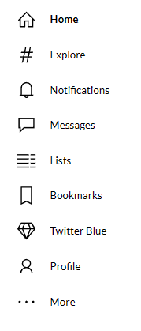
Build a gallery menu (twitter)

Slide 44
Intro to components
Components are serve DRY
Awesome, but underused
Proper planning can save hours/days/weeks of dev time
Undocumented components = meh

Slide 45
Intro to components: Start with docs
Name - make it meaningful
stick with a convention
This is makes it easier for makers to find the right component
Description – what shall it do?
display information
gather data from a user
facilitate how users interact with UI?
Context – where shall it run?
Standalone?
Host app like Teams, SharePoint?
Desktop, mobile, Kiosk device?
Use cases – whom does it serve

Slide 46
Intro to components: Design considerations
Colors:
A good practice is to layout a color palette for your component or your component library and then stick to this.
Use https://coolors.co
To harmonize the look you can use the 60-30-10 rule
60% : primary color (dominant)
30% : secondary color (supporting)
10% : accent color
Shapes & Sizes:
rounded corners?
border thickness, width and height of your component
media such as images, icons etc.

Slide 47
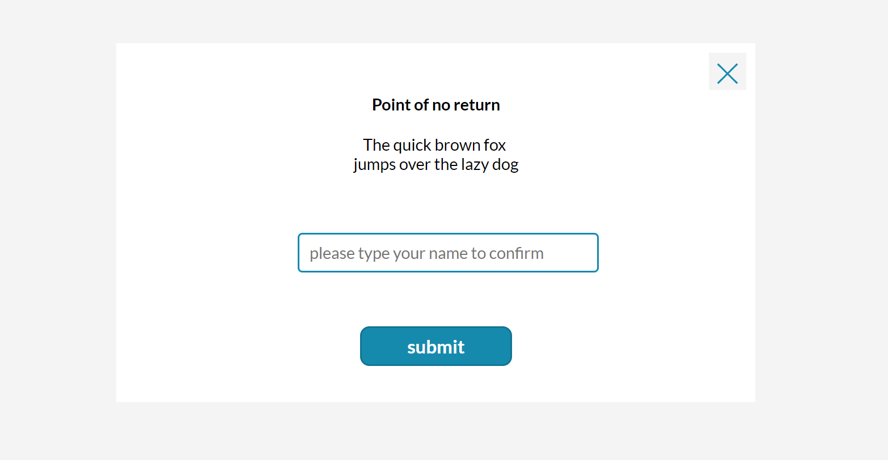
Intro to components: example: pop up

Slide 48
Intro to components: example: Add flexibility with input properties
Define input properties for the colors you want to use: `primaryColor`, `secondaryColor`, `accentColor`
Assign your color palette values to them as default values
Create input properties for radius of buttons, standard width or height of controls you use, and more.
The goal is to avoid hard coded values as you don't want to go over the entire component over and over just because someone requests 'just a tiny change' 🙃

Slide 49
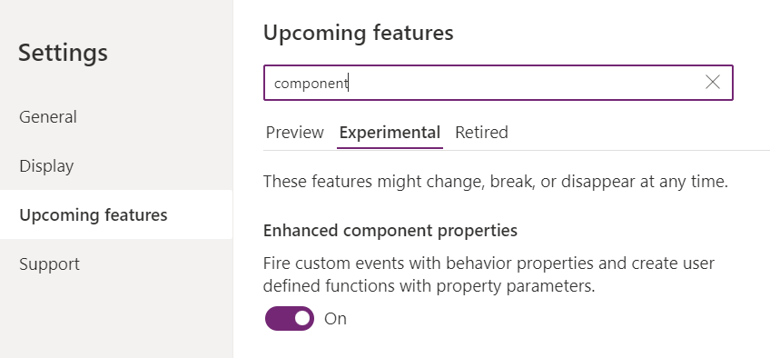
Intro to components: Fire custom events with Behaviour properties
Add a behavior property `onClose` (boolean) to our component
Add an `X` icon to the component
Assign the property to the **OnSelect** of the `X` icon
In your component instance, set the **OnSelect** property of your component to `Set(isCmpVisible, false)`
In your component instance, set the **Visible** property of your component to `iscmpVisible`

Slide 50
Intro to components: Content
Define input properties for every text, number, table, or image being displayed, such as
mainButtonContent
labelHeaderContent
labelBodyContent

Slide 51
Intro to components: return values to your app with output properties
If users interact with our components and we want to know *what* they did, we will need to return values from our component to the app. We do this with output properties.
For example, if our component contains a TextInput control and we want to know the **Text** property of that in our app, we will need to create an output property, hook that to `TextInput.Text` and then use the Output property in the app to return that value.

Slide 52
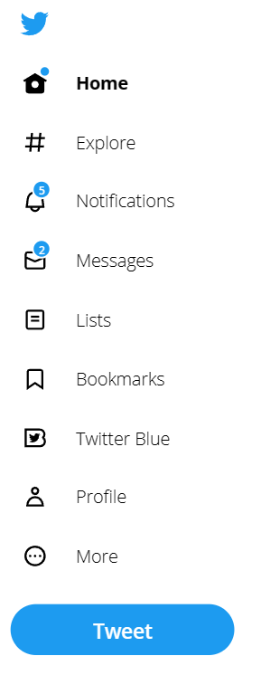
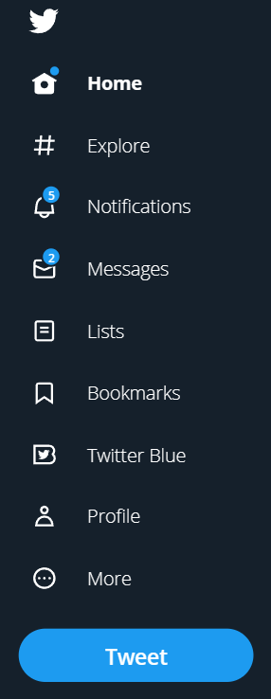
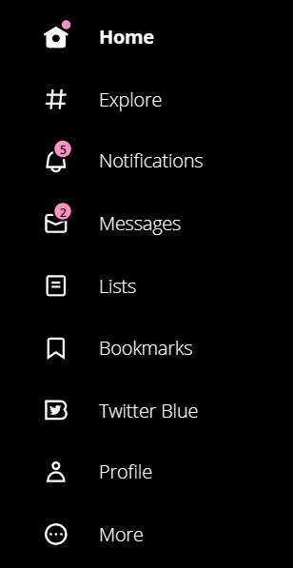
Build a component: the twitter menu

Slide 53


Accessibility

Slide 54
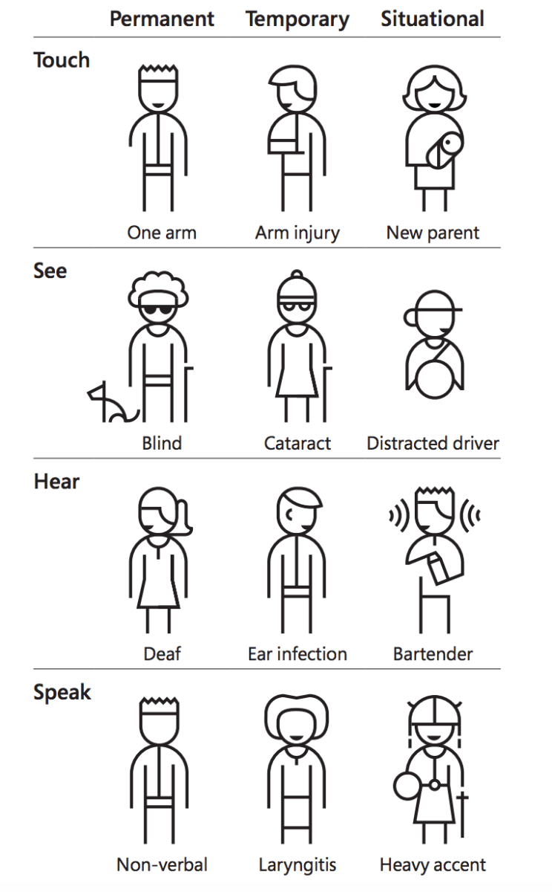
Types of accessibility needs
Source: https://inclusive.microsoft.design/

Slide 55
BUT I have no users with disabilities
Situational disabilities
CONGRATULATIONS! You’ll make it impossible to employ someone with a disability

Slide 56

‘But accessibility makes my apps look ugly 🙄’

Slide 57




BUT I have no users with disabilities
Improved experience for EVERYONE
More user-friendly
Cleaner and simpler design
Easier to fix

Slide 58
Accessibility standards
WCAG 2.2
Web Content Accessibility Guidelines
https://www.w3.org/WAI/standards-guidelines/wcag/

Slide 59
Accessibility in Power Platform
Color contrasts
Easy to understand
Alt text
Keyboard navigation
Focused borders
Logical layout
Accessibility checker

Slide 60
Most important accessibility concepts in Canvas Apps
Color contrasts
Use of screen readers
Keyboard navigation

Slide 61
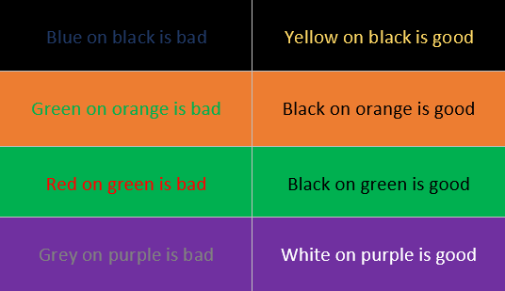
Color contrast: examples
Source: https://www.csun.edu/universal-design-center/web-accessibility-criteria-color-contrast

Slide 62
Color contrast: guidelines
For AAA conformance rating you need a contrast ratio of 4.5:1 for large text and 7:1 for regular text
This is a contrast ratio of 1.5:1
This is a contrast ratio of 3:1
This is a contrast ratio of 4.5:1
This is a contrast ratio of 7:1
Use online contrast checkers or your browser dev tools!
Notes:
Color Contrast 1:4.5 laut WCAG

Slide 63
Screen readers
Ctrl + Shift + U
(Microsoft Edge)
Ctrl + Win + N
(Windows)
Even better: ask someone who actually uses a screen reader

Slide 64
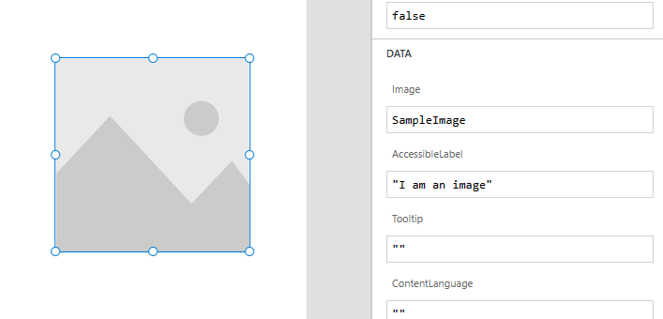
Screen readers: accessible labels

Slide 65
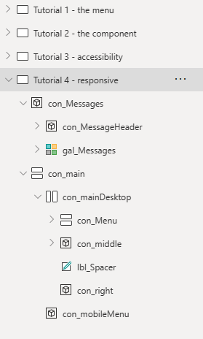
Screen readers: screen names

Slide 66
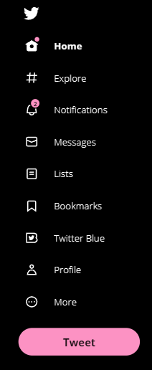
Screen readers: use galleries to provide context

Slide 67
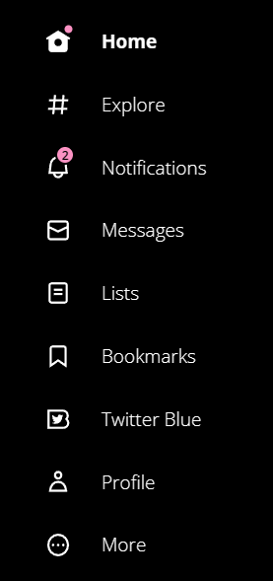
Keyboard navigation

Slide 68
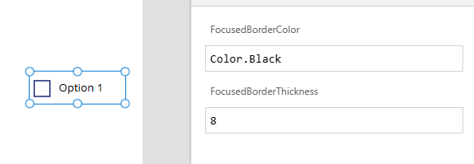
Keyboard navigation: focused borders

Slide 69
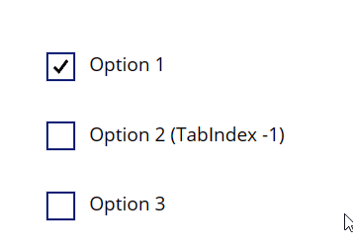
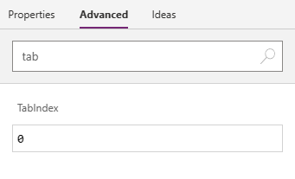
Keyboard navigation: TabIndex
Only use 0 (accessible via Tab ➔ everything that is clickable)
And -1 (not accessible via Tab)

Slide 70
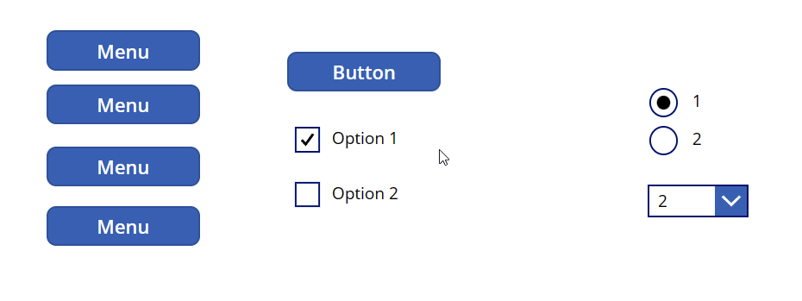
Keyboard navigation: Order
Follows Y-Values of your controls

Slide 71
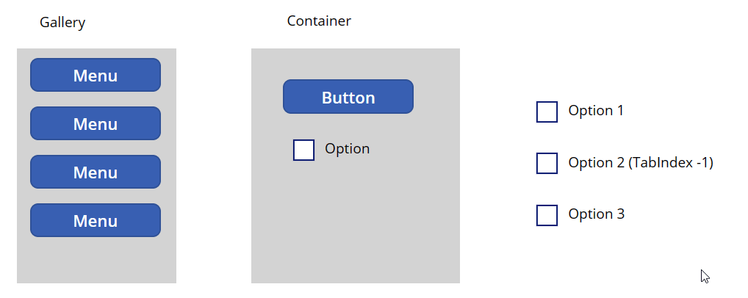
Galleries and Containers will help you!

Slide 72
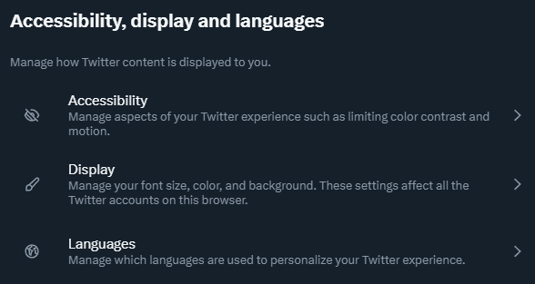
Accessibility: things to consider

Slide 73
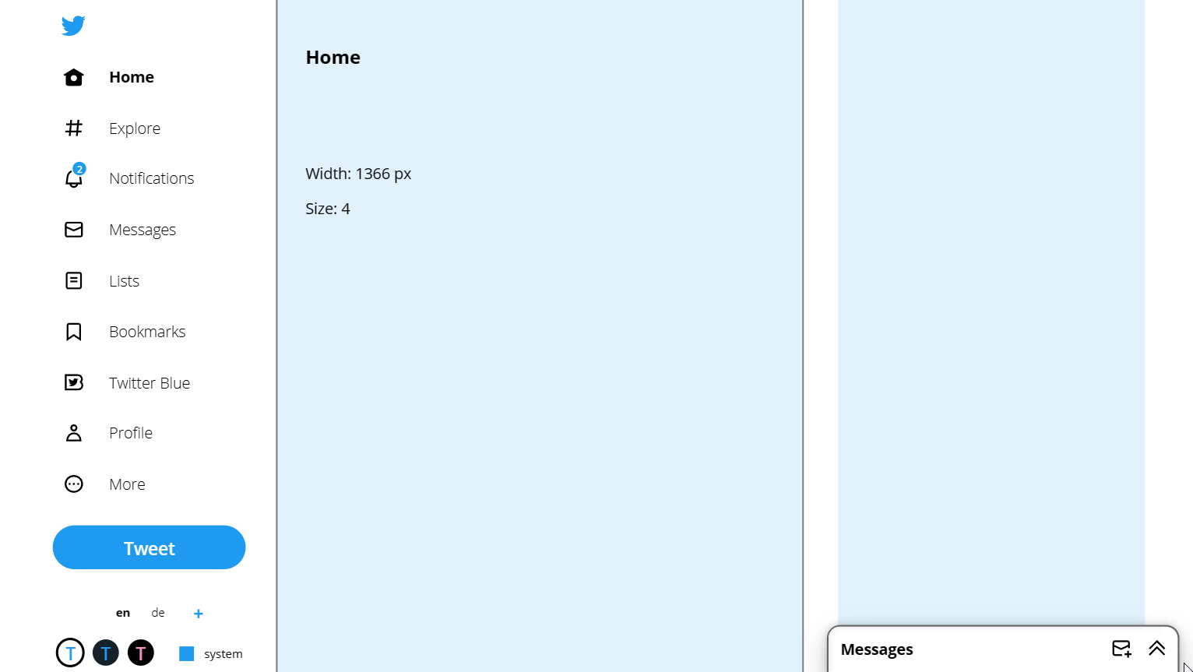
Accessibility: things to consider

Slide 74

Container

Slide 75
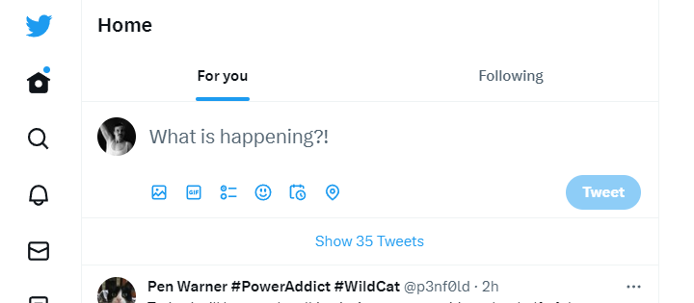
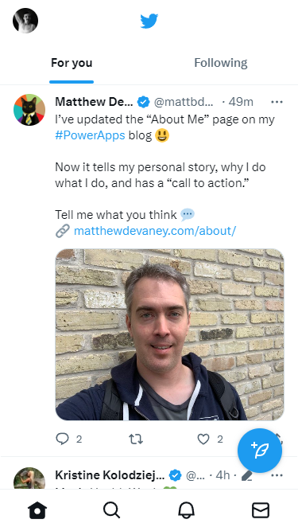
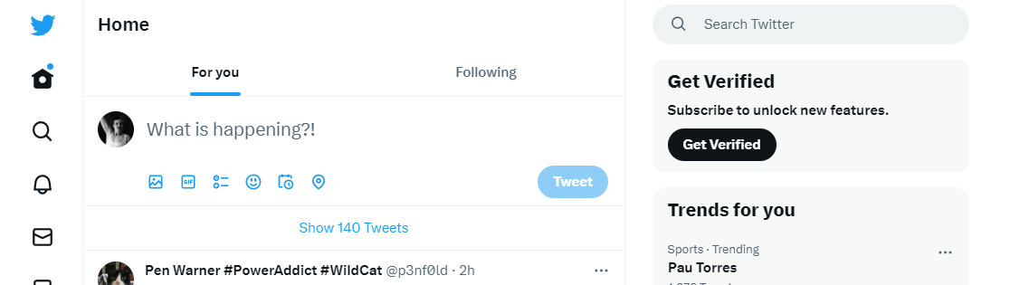
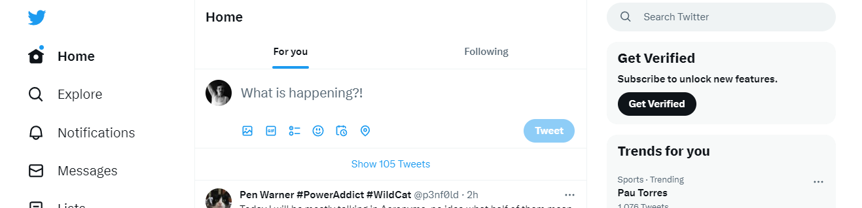
Responsive design on X homepage

Slide 76
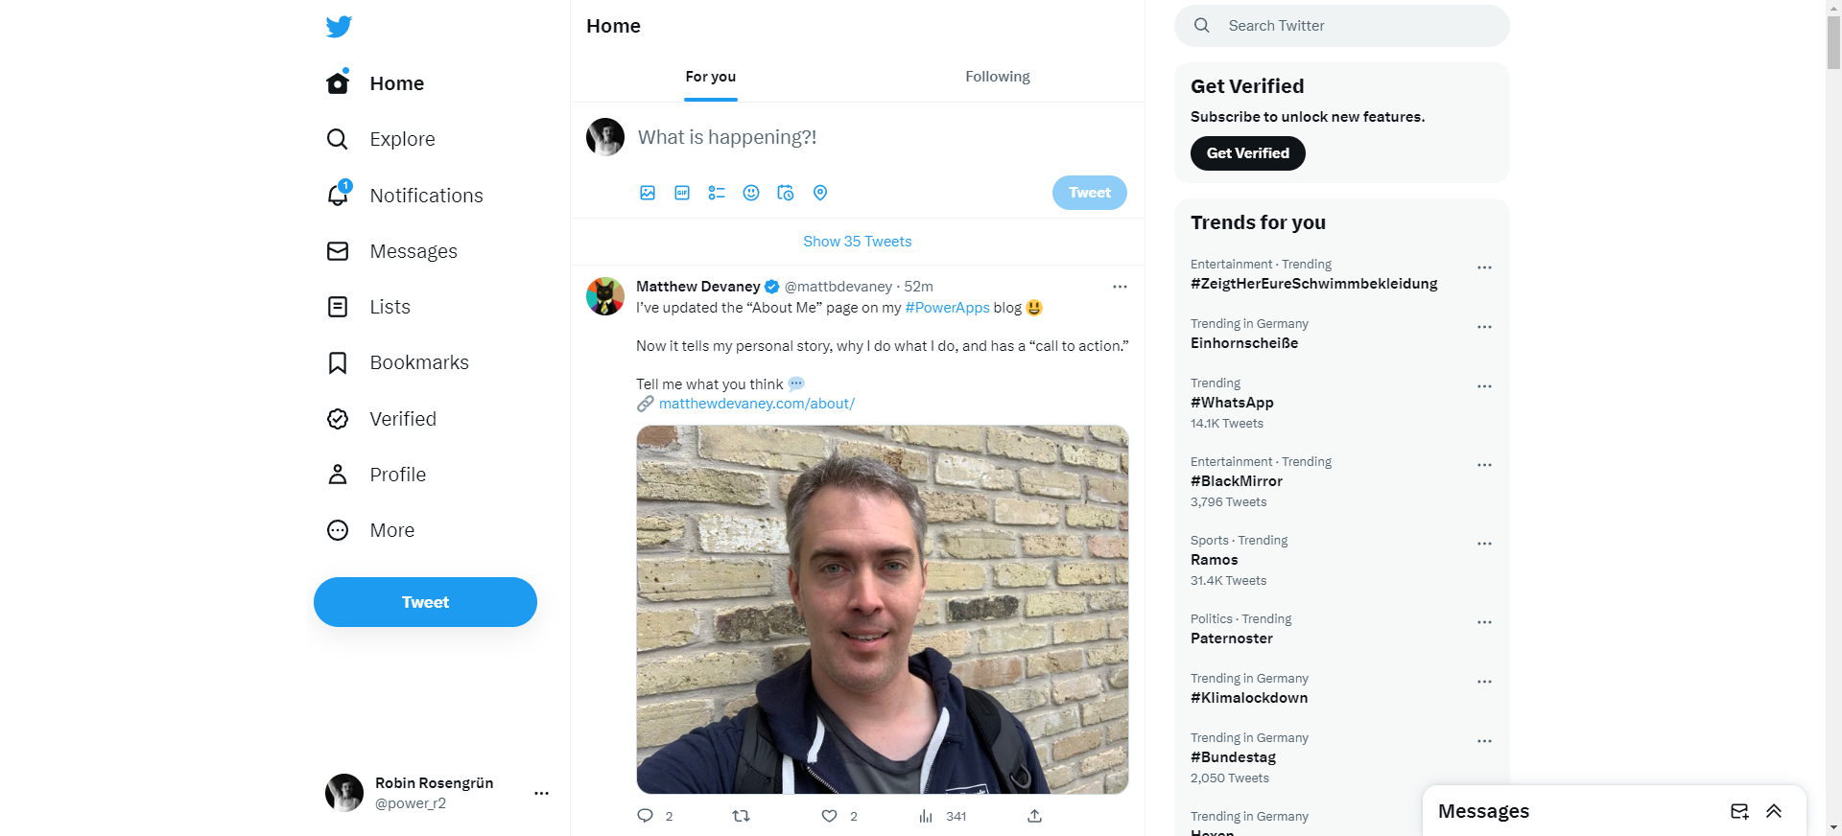
Identify the main containers
left
middle
right
messages

Slide 77
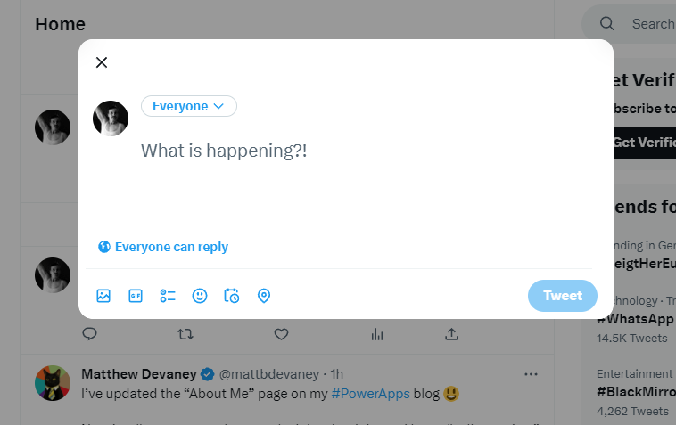
Responsive design on twitter homepage

Slide 78

Notes:
End Slide: Rate This Session
Final Slide on all presentations.
The speaker should not edit, move or delete this slide.

